Slide 1

MACHINE LEARNING

Slide 2

1
What is ML
2
Types of ML
3
Application of ML
4
What is Scikit-Learn
5
Scikit-Learn Installation

Slide 3

What is Machine Learning
It is a type of Artificial Intelligence that allows software applications to learn from the data and become more accurate in predicting outcomes without human intervention.
Training Data
Learn Algorithm
Build Model
Perform
Feedback

Slide 4





Applications of Machine Learning
Stock Market Prediction
Self Driving Cars
Product Recommendation
Online Fraud Detection
Image recognition

Slide 5
Types of Machine Learning
01
02
03
Supervised
Unsupervised
Reinforcement
This is a process of an algorithm learning from the training dataset
This is a process where a model is trained using an information which is not labelled.
Reinforcement learning is learning by interacting with a space or an environment.

Slide 6
Introduction to Scikit-learn
Open source library
Built on Numpy, Scipy & Matplotlib
Many Tuning Parameters
Documentation & Support

Slide 7


Installation of Scikit-learn
pip install scikit-learn
conda install scikit-learn

Slide 8
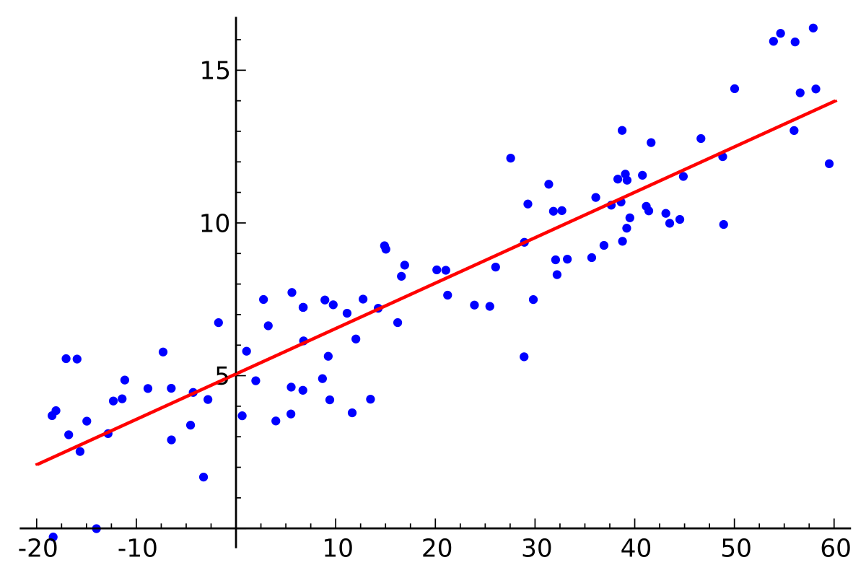
What is Linear Regression
Linear regression is a linear approach to modeling the relationship between dependent variable and one or more independent variables.

Slide 9
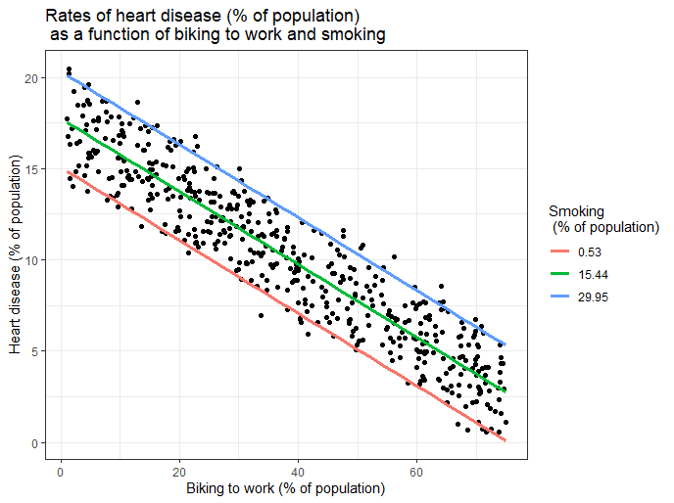
Types of Linear Regression
Simple Linear Regression
Multiple Linear Regression

Slide 10
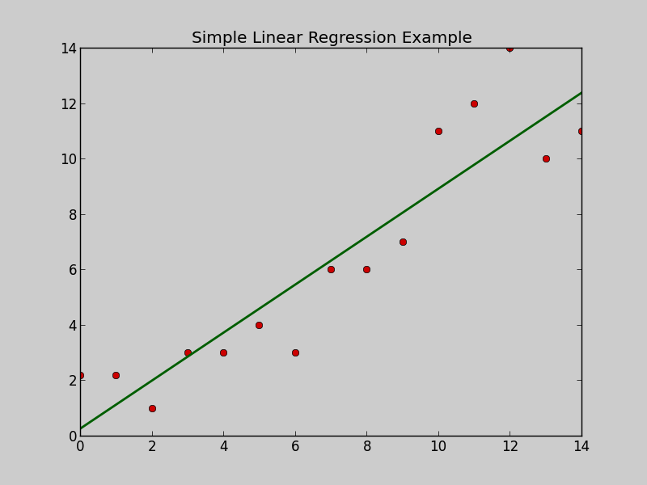
What is Simple Linear Regression
Simple linear regression is a regression model that estimates the relationship between one independent variable and one dependent variable using a straight line. Both variables should be quantitative.
y = mx + c

Slide 11
Linear Regression Model
1
from sklearn.linear_model import LinearRegression
2
regressor = LinearRegression()
3
regressor.fit(X_train, y_train)
4
y_pred = regressor.predict(X_test)

